Slide 1
Data Collection ——Improvement of Existing Data and Models——
“Data Mining: Methods and Applications”

Slide 2
Contents
Background
Data Acquisition
Data Labeling
Improvement of Existing Data and Models
How to Decide which Data Collection Techniques to Use When
Interesting Future Research Challenge

Slide 3
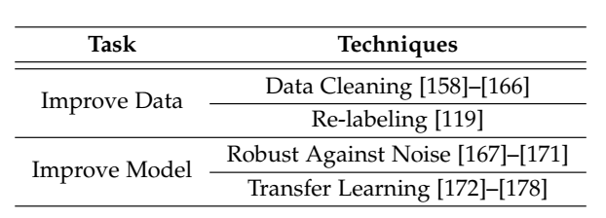
Improvement of Existing Data and Models
Using Existing Data and Models
Scenarios
It may be difficult to find new datasets because the application is too novel or non-trivial for others to have produced datasets.
simply adding more data may not significantly improve the model’s accuracy anymore.
Re-labeling or cleaning the existing data may be the faster way to increase the accuracy.

Slide 4
Improvement of Existing Data and Models
Improving Existing Data: the data can be noisy and the labels may be incorrect.
Data Cleaning: To Introduce in Data Pre-process
Re-labeling
If the labels are noisy, then the model accuracy plateaus from some point and does not increase further, no matter how many more labeling is done.
Repeated labeling using workers of certain individual qualities can significantly improve model accuracy where a straightforward round robin approach(轮询调度算法) already give substantial improvements, and being more selective in labeling gives even better results.

Slide 5
Improvement of Existing Data and Models
Improving Models
Robust Against Noise and Bias : there is a large number of noisy or even adversarial labels and a relatively smaller number of clean labels. Simply discarding the noisy labels will result in reduced training data, which is not desirable for complex models.
Transfer Learning : When there is not enough training data or time to train from scratch, a common technique is to start from an existing model that is well trained (also called a source task), one can incrementally train a new model (a target task) that already performs well.
AlexNet, VGGNet
TensorFlow Hub, AutoML
Problems: What to transfer, How to transfer, and When to transfer.

Slide 6
Contents
Background
Data Acquisition
Data Labeling
Improvement of Existing Data and Models
How to Decide which Data Collection Techniques to Use When
Interesting Future Research Challenge

Slide 7
Thanks！
Notes:
工作新意图发现

